Slide 1
An Auto Insurance Underwriting Analysis
Nahum Ghebrehiwet

Slide 2
Introduction
Auto Insurance is amongst the largest insurance category in the United States valued at over $400 billion (Mordar Intelligence).
The growth and survival of any insurance company relies on its ability to carefully assess which applicants it should accept at which price.
Insurance companies need to carefully understand the characteristics of their applicants.

Slide 3
Goal
The goal is to analyze the applicants for an auto insurance company. The information provides insight on different characteristics of the applicants such as demographics and risk.
Determine which applicants are of high or low risk.
Create an optimal pricing strategy for insurance applicants

Slide 4
Tools
Microsoft Excel is the main tool for this analysis. The following analysis involves using ifs, XLOOKUP, pivot tables and charts.
There is also Power BI used for this analysis for summary statistics visualization.

Slide 5
Applicant Demographics

Slide 6
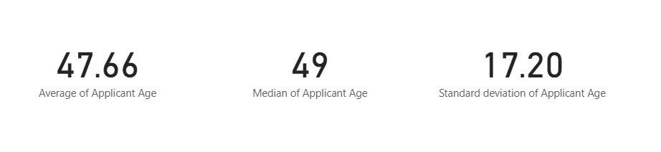
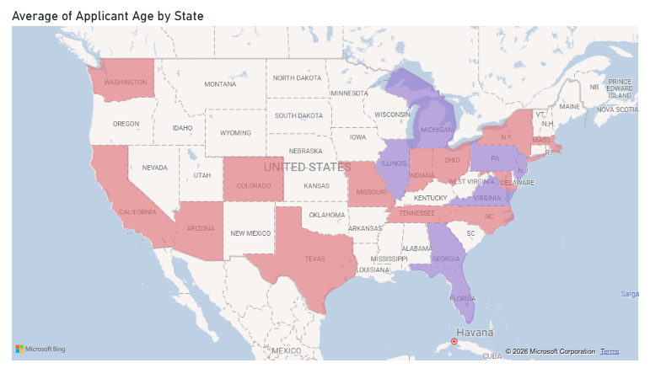
Applicant Age

Slide 7
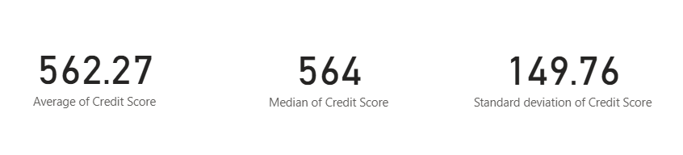
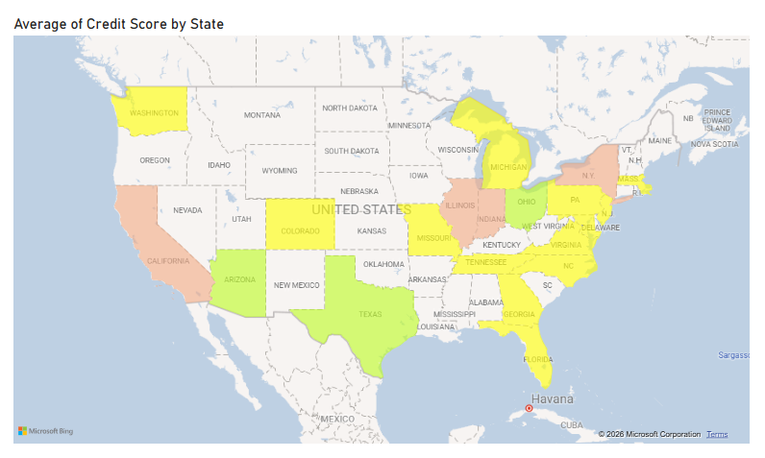
FICO Credit Score

Slide 8
Vehicle info

Slide 9
Other DEMOGRAPHICS

Slide 10
Demographics info
The data reflects an even distribution.
However, the applicant data is significantly different than U.S demographics
Age, FICO Score, and marital status are much more different.

Slide 11
Risk

Slide 12
Risk rating
Applicants are given a risk rating
based on key info of their driving
behavior.

Slide 13
Risk info
Overall risk appears to be much higher than U.S averages
All risk characteristics appear to be higher than U.S averages (Insurify Insights).

Slide 14
Premium
Different applicants have different characteristics
Charging a uniform price would leave profit and market share for other insurance competitors
Price discrimination/Premium accommodates differences in applicant characteristics.
Our base price will be $80

Slide 15
Premium - Age
Premium multiplier by age

Slide 16
Premium – Driving Experience

Slide 17
Premium – At Fault Count

Slide 18
Premium – Fico Score

Slide 19
Premium - Mileage

Slide 20
Premium - dui

Slide 21
Premium - coverage

Slide 22
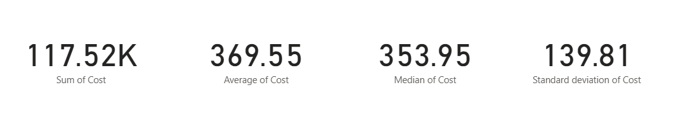
Premium formula
Example
Applicant Age | Years_Exp | At_Fault_Accidents | credit_score | annual_milage | DUI | Coverage | Risk Rating | Cost
1.21 | 1.25 | 1 | 1.39 | 1.1 | 0.75 | 1 | 7.7 | 138.75675

Slide 23
Goals
This project carefully cleaned and analyzed the different characteristics of insurance applicants.
Applicants were then given a risk rating depending several factors.
We created a premium formula based on applicant data.

Slide 24
Conclusion
Auto insurance is one of the largest insurance categories in the United States.
This analysis provides an auto insurance pricing that considers the various characteristics of applicants.

Slide 25
Sources
Mordor Intelligence. "United States Motor Insurance Market Size and Share." Mordor Intelligence, www.mordorintelligence.com/industry-reports/united-sates-motor-insurance-market. Accessed 11 Sept. 2026.
Insurify Insights. "Driving Drunk: States with the Most DUIs (2019)." Insurify, 28 July 2022, insurify.com/insights/driving-drunk-states-with-the-most-duis/. Accessed 11 Sept. 2026.

